Slide 1
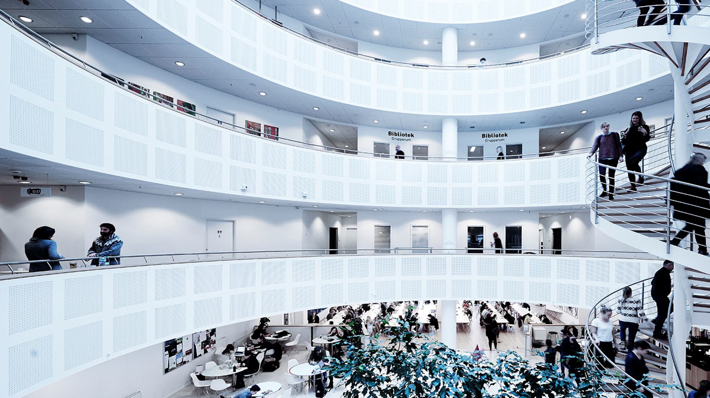

TECHNICAL FACULTY OF
IT AND DESIGN
NAVN

Slide 2
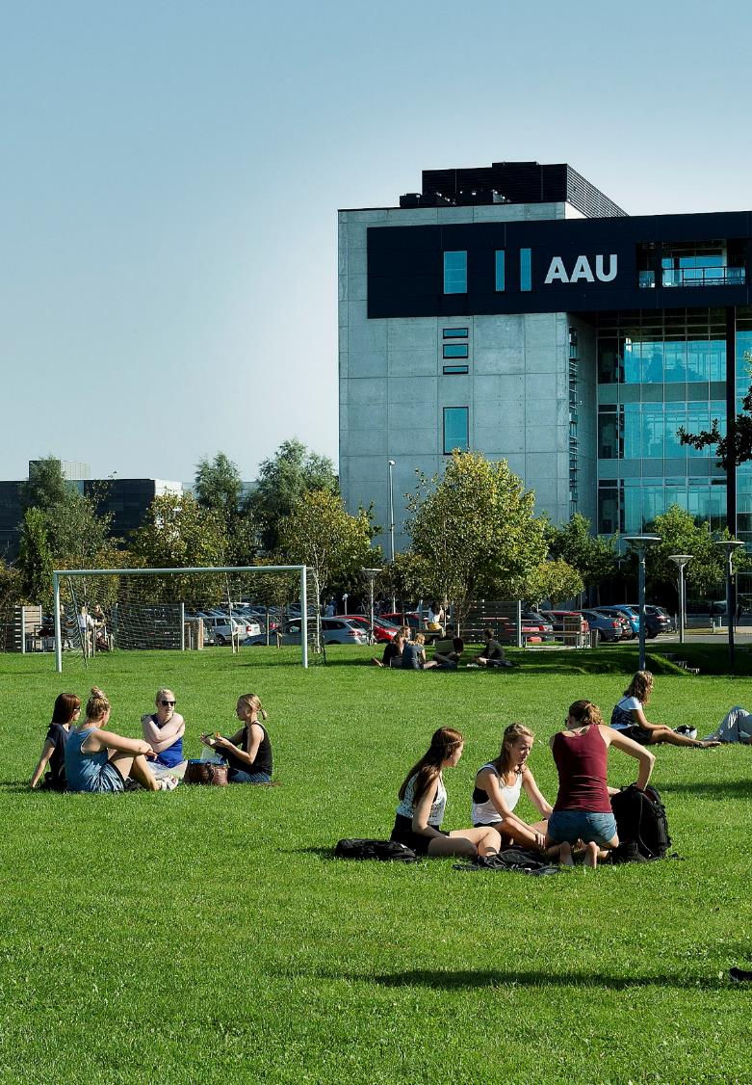
CONTENT
TECH AND AAU IN GENERAL
DIGITALISATION AND SUSTAINABILITY
DEPARTMENTS
EDUCATION
RESEARCH
KNOWLEDGE COLLABORATION

Slide 3
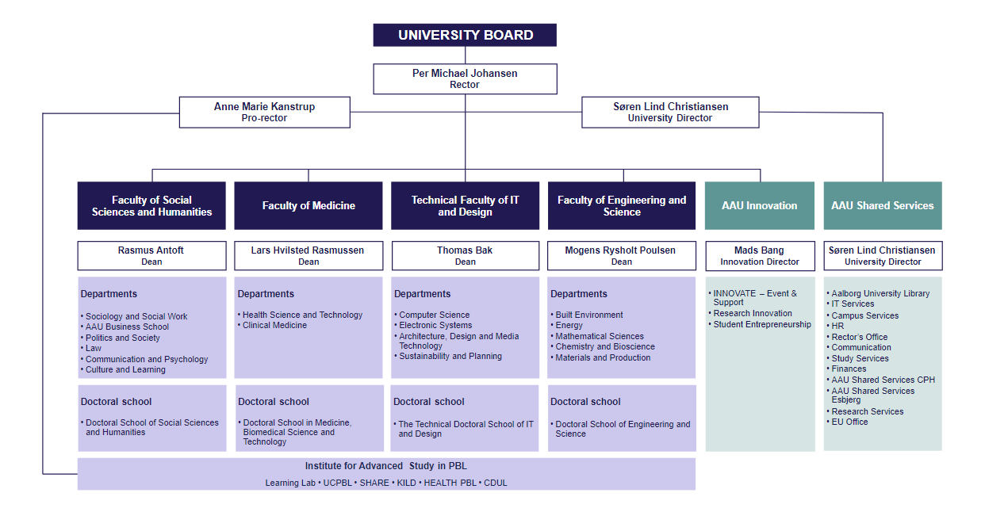
AAU – ORGANISATION
Updated: August 2023

Slide 4
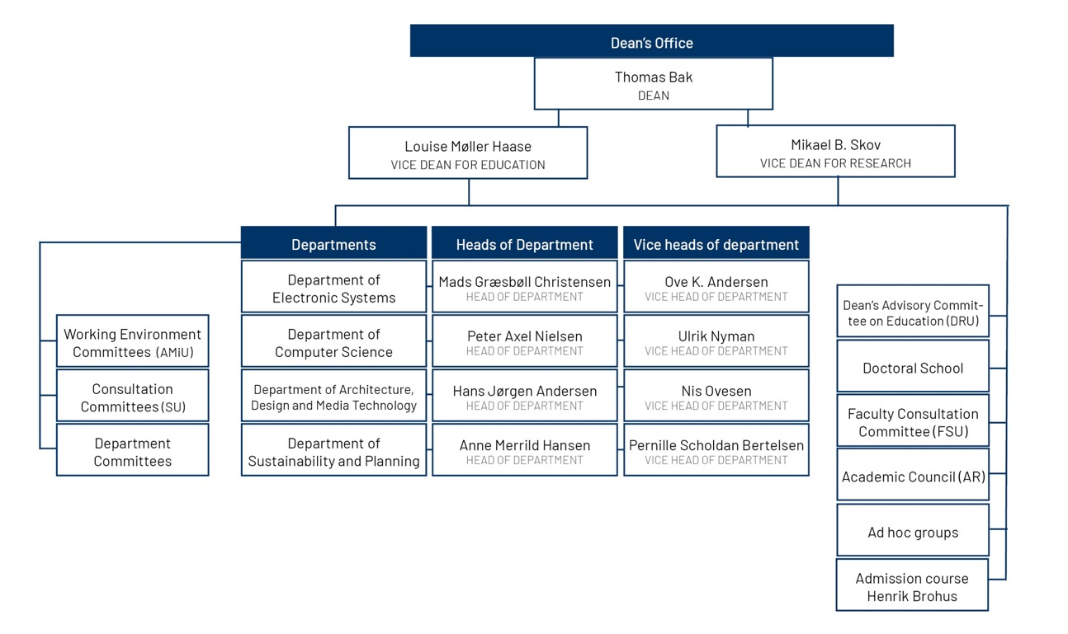
TECH – ORGANISATION

Slide 5



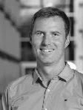
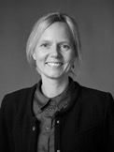
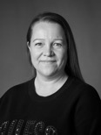


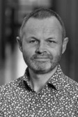





TECH – MANAGEMENT
Thomas Bak
Dean
Mads G. Christensen
Head of Department, Electronic Systems
Ove K. Andersen
Vice Head of Department,
Electronic Systems
Jimmy Jessen Nielsen
Head of Doctoral School
Louise Møller Haase
Vice Dean for education
Anne Merrild Hansen
Head of Department,
Sustainability and Planning
Pernille Scholdan Bertelsen
Vice Head of Department,
Sustainability and Planning
Henrik Brohus
Leader of Admission course
Mikael B. Skov
Vice Dean for research
Hans Jørgen Andersen
Head of Department, Architecture, Design and Media Technology
Nis Ovesen
Vice Head of Department,
Architecture, Design and Media Technology
Lise Dahlgaard
Head of secretariat
Peter Axel Nielsen
Head of Department, Computer Science
Ulrik Nyman
Vice Head of Department,
Computer Science

Slide 6
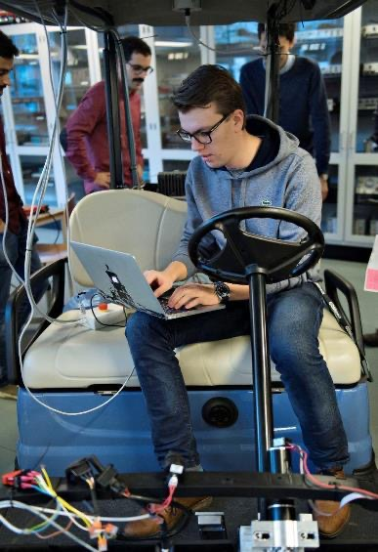
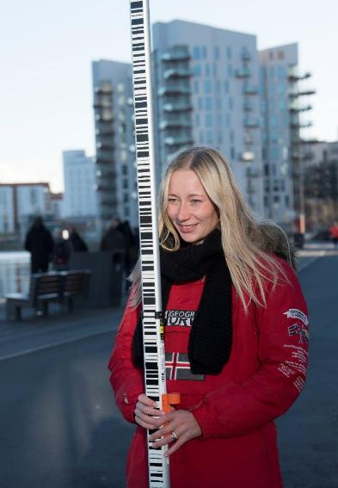
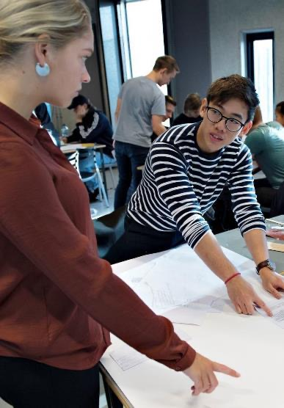
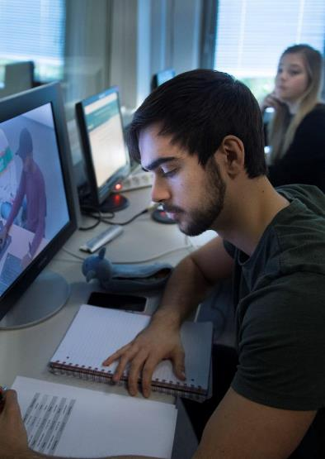
TECHNICAL FACULTY OF IT AND DESIGN
Addresses global challenges through education, research and knowledge collaboration that create tomorrow’s:
digital solutions that consider human behaviour and needs
technology and knowledge for sustainability
architecture and design that integrate aesthetics and engineering
Examples of research:
Planning: Energy, water infrastructure and circular economy
Digitalization: Internet of things, big data, virtual reality and cyber-physical systems
Autonomous systems: Robots, drones and satellites
Communication: Connectivity 5G and antenna research
Human Touch: Sustainable architecture and design
Notes:
Eksempler
Virtual reality: Bekæmpe angst hos børn med autisme. Få ældre til at motionere mere
Big data: Sikre en mere effektiv, sikker og miljøvenlig trafik
Robotter, droner og satellitter: Udvikling af selvkørende robotter, der kan vise vej i lufthavne og på hospitaler
Kunstig intelligens: Forbedre høreapparater ved at fjerne støj og tydeliggøre tale
Bæredygtig arkitektur/Vedvarende energi: Udvikling af NUL-energihuse. Verdens største forskningsindsats inden for fjernvarme
Vandinfrastruktur: Bidrage til at mindske et globalt årligt vandspild på 10.000 milliarder liter i verdens første modulopbyggede laboratorium

Slide 7

TECH PROFILE
We address challenges through education, research and knowledge collaboration that create the future:
Digital solutions that consider human behaviour and needs.
Technology and knowledge for sustainability.
Architecture and design that integrate aesthetics and engineering.
We act by timely involvement of the 17 UN Sustainable Development Goals in our research, education and cooperation.
SIDE
7

Slide 8

A BALANCED
GLOBAL COMMUNITY
TRANSFORMATIVE
KNOWLEDGE
DIGITALE SOLUTIONS
AND DESIGN
SOLUTION-ORIENTED GRADUATES
The sustainable transition requires a transformation of the global community – economically, socially and environmentally – through new technologies and design of products, services, interiors and infrastructures.
TECH will use the breadth of its research environments to develop technologies and solutions that meet current needs as well as support the transformation towards a sustainable society.
The transformation towards a sustainable society requires foundational and transformative knowledge in close interaction with relevant actors.
TECH will take advantage of its unique position and experience as the country's leading partnering university to produce knowledge and solutions in the short and long term.
Digital technology, design and planning shape society and create opportunities through the development and integration of digital, physical and human aspects.
TECH will – via its core competencies and the breadth of its research environments – provide value-creating knowledge, rethink the digitalisation of processes and design intelligent systems in a human-centred perspective.
Societal development requires graduates who can contribute holistically to increased competitiveness and innovation capability.
TECH will – through focus on problem-based learning, interdisciplinarity in the integration of STEM* and SSH*, variation in forms of collaboration, innovation, entrepreneurship and lifelong learning – ensure that graduates have the competences demanded by the labour market of the future.
*STEM: Science, Technology, Engineering and Mathematics
*SSH: Social Sciences and Humanities.

Slide 9
TECH - BY THE NUMBERS
4 departments – 1 doctoral school – about 60 degree programmes
4,300 students – of which 700 are international students
215 Ph.D.-students
770 full time employees
833 million in budgeted revenue
AALBORG
2900 students
COPENHAGEN
1400 students
Notes:
DK-billede erstattes: https://www.colourbox.com/vector/denmark-vector-2332864
Number of students https://www.aau.dk/om-aau/noegletal/studerende/
Number of full time employees https://www.en.aau.dk/about-aau/key-figures/staff/
Number of Ph.D.- students https://www.en.aau.dk/about-aau/key-figures/research/

Slide 10


HIGH INTERNATIONAL LEVEL
1
NO. 1 IN EUROPE AND NO. 11
IN THE WORLD
FOR ENGINEERING
NO. 1 IN EUROPE AND
NO. 4 IN THE WORLD FOR
ENGINEERING PROGRAMMES
BEST DANISH UNIVERSITY
FOR PARTNERING WITH
INDUSTRY
NO. 9 IN THE WORLD AND NO. 1. I DENMARK FOR SUSTAINABILITY
Aalborg University is the 11th best university worldwide for engineering and the highest ranked European university in the field.
U.S. News & World Report, 2023
MIT analysis ranks Aalborg University as
best in Europe and No. 4 in the world for
engineering programmes.
MIT report: “The global state of the art in
engineering education, 2018”
The Confederation of Danish Industry (DI) has
designated Aalborg University the best Danish
university to partner with.
DI analyse 2020: Danmark tilbage på
vidensporet V
Aalborg University ranks no. 9 in the world among approx. 1,600 universities and no. 1 in Denmark based on universities' impact on the 17 UN SDGs.
Times Higher Education, 2023
Notes:
BEDSTE INGENIØR-UNIVERSITET I EUROPA OG NR. 11 I VERDEN: På verdensplan overgås AAU kun af Massachusetts Institute of Technology (MIT) samt ni universiteter fra Kina, Singapore og Hongkong.

Slide 11

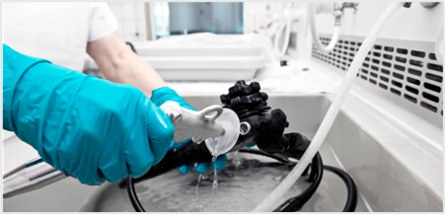
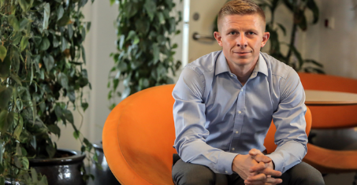
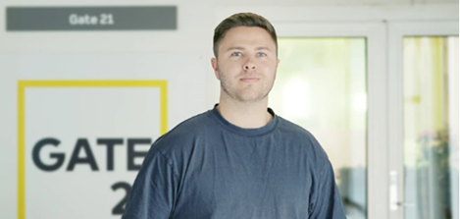
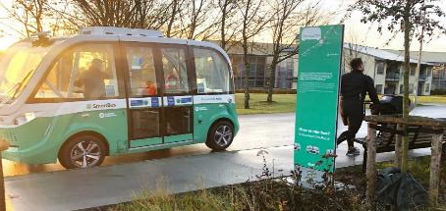


DIGITALISATION & SUSTAINABILITY
STUDENTS DEVELOP SUSTAINABLE ROBOTS FOR ROOM DISINFECTION IN THE HEALTHCARE SECTOR
RETHINKING THE WORLD’S ENERGY CONSUMPTION TOWARDS 100 % RENEWABLE ENERGY
THESIS: ENERGY REDUCTION IN THE TRANSITION FROM NATURAL GAS TO DISTRICT HEATING
PLANT-BASED FOOD REDUCES AGRICULTURAL CLIMATE IMPACT
AUTOMATED ROAD TRANSPORTATION SUPPORTS SOCIAL SUSTAINABILITY IN CITIES
AI USED FOR COLLECTING IMPROVED MARITIME DATA TO UNDERSTAND ENVIRONMENTAL ISSUES

Slide 12

WORLD-CLASS DIGITALISATION
N0. 1 in Denmark
Largest admissions to IT programmes in Denmark
In the top 3 among computer scientists in Denmark
Number two and three on the list of computer scientists in Denmark with the highest quality and relevance as measured by citations are professors from AAU.
1
NO. 1 IN EUROPE AND NO. 11
IN THE WORLD
FOR ENGINEERING
AAU accounts for 22% of the Danish universities’ total intake
NO. 1 IN EUROPE AND
NO. 4 IN THE WORLD FOR
ENGINEERING PROGRAMMES
Notes:
Største optag på IT-uddannelser i Danmark
(UFM 2022) AAU står for 22 procent. Nr. 2 er Aarhus Universitet med 19 procent og nr. 3 er DTU med 16 procent.
I top tre blandt dataloger i Danmark (mest citerede). Nr. 2 er Christian S. Jensen og nr. 3 er Kim Guldstrand Larsen – begge fra AAU. (h-indeks, Google Scholar 2021).
Inden for ingeniørvidenskab er Aalborg Universitet placeret som nr. 11 blandt verdens universiteter. Det er den bedste placering i Europa.
(U.S. News & World Report, 2023)
Analyse fra MIT kårer AAU som Europas bedste og verdens fjerdebedste universitet inden for ingeniøruddannelser.
(MIT-rapport “The global state of the art in engineering education, 2018”)
BEDSTE INGENIØR-UNIVERSITET I EUROPA OG NR. 11 I VERDEN: På verdensplan overgås AAU kun af Massachusetts Institute of Technology (MIT) samt ni universiteter fra Kina, Singapore og Hongkong.

Slide 13





WORLD-CLASS SUSTAINABILITY
AAU ranks 9th in sustainability among approximately 1,600 universities.
No. 2 in the world
SDG #4: Quality in education
No. 2 in the world:
SDG #10: Reduced inequalities
No. 2 in the world:
SDG #17: Partnerships for
the goals

Slide 14
DEPARTMENT OF ELEKTRONIC SYSTEMS
Research
AUTOMATION AND CONTROL
CONNECTIVITY
ANTENNAS, PROPAGATION AND MILLIMETER-WAVE SYSTEM
WIRELESS COMMUNICATION NETWORKS
COMMUNICATION, MEDIA AND INFORMATION TECHNOLOGIES
AI AND SOUND

Slide 15
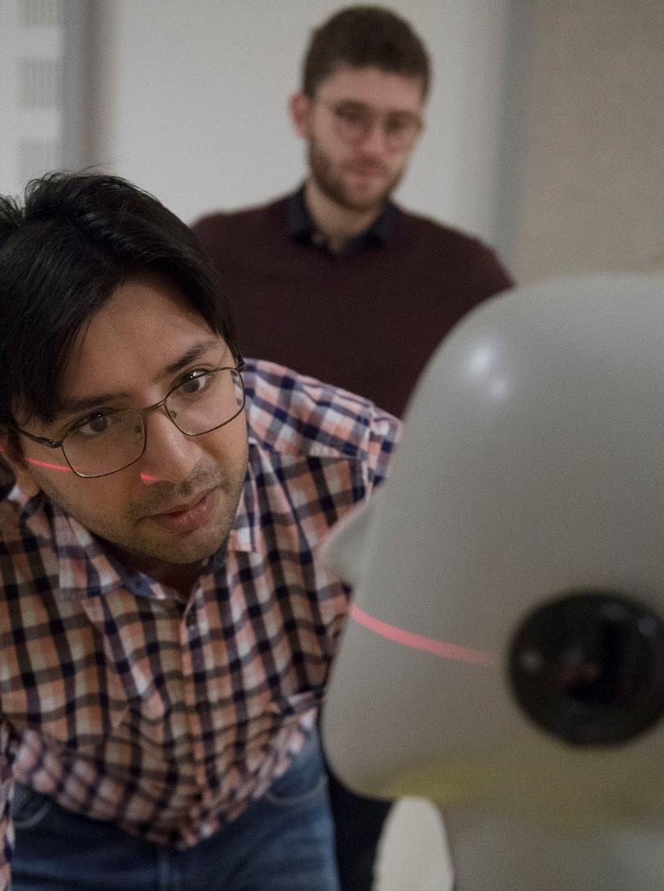
DEPARTMENT OF ELECTRONIC SYSTEMS
Research
Antennas and mobile technology
Wireless communication
Acoustics and hearing
Robot technology
Cyber security
Aerospace and satellites
Artificial intelligence and IoT

Slide 16
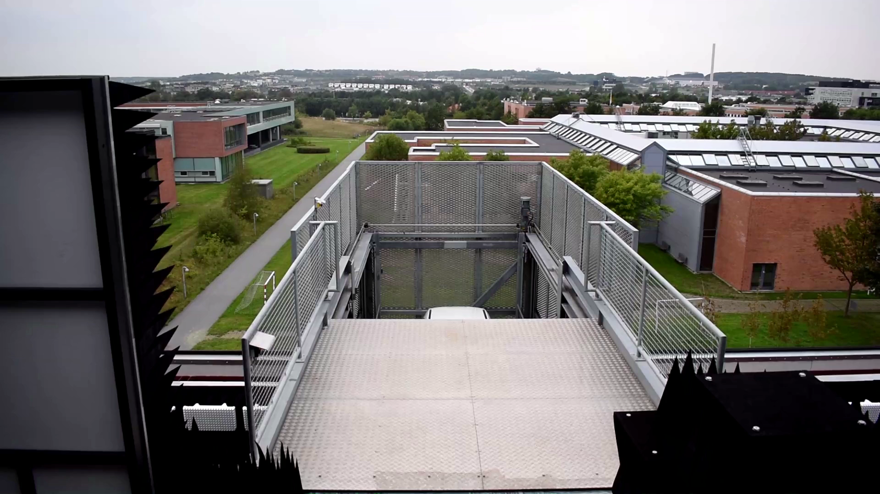
DEPARTMENT OF ELECTRONIC SYSTEMS
Research
NEW ANTENNA LABORATORY – UNIQUE IN THE WORLD
The largest of its kind in the world with state-of-the-art technologies
The first laboratory in the world where roof and walls are laterally slidable
Hoist and measuring platform able to transport objects of 3500 kg into the room
Combines the possibilities of a closed radio laboratory and outside measuring stations
Simulates an infinitely large room that is closed and radio dead
Is able to measure huge objects and signals over enormous distances without ground reflection and other influences

Slide 17
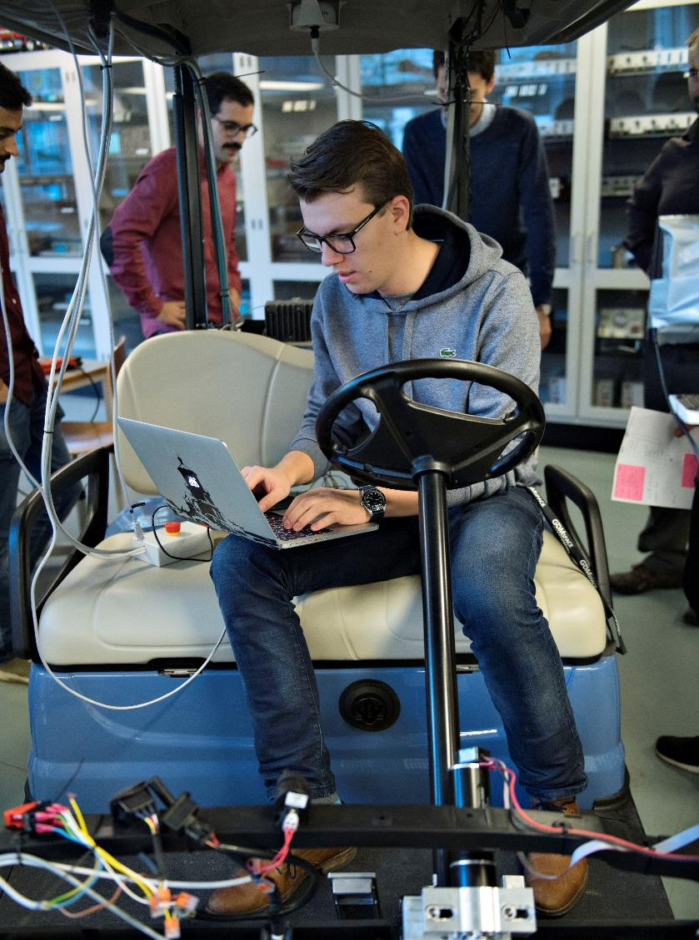
DEPARTMENT OF ELECTRONIC SYSTEMS
Education
Offers a wide range of bachelor and master programmes in the technical-scientific area, i.e. robotics, information and communication technology, wireless communication systems, etc.

Slide 18
DEPARTMENT OF COMPUTER SCIENCE
Research
DATA ENGINEERING, SCIENCE AND SYSTEMS
DATA, KNOWLEDGE AND
WEB ENGINEERING
DISTRIBUTED, EMBEDDED AND INTELLIGENT SYSTEMS
HUMAN-CENTERED COMPUTING
Interdisciplinary team
ARTIFICIAL INTELLIGENCE AND MACHINE LEARNING (AI-ML)

Slide 19
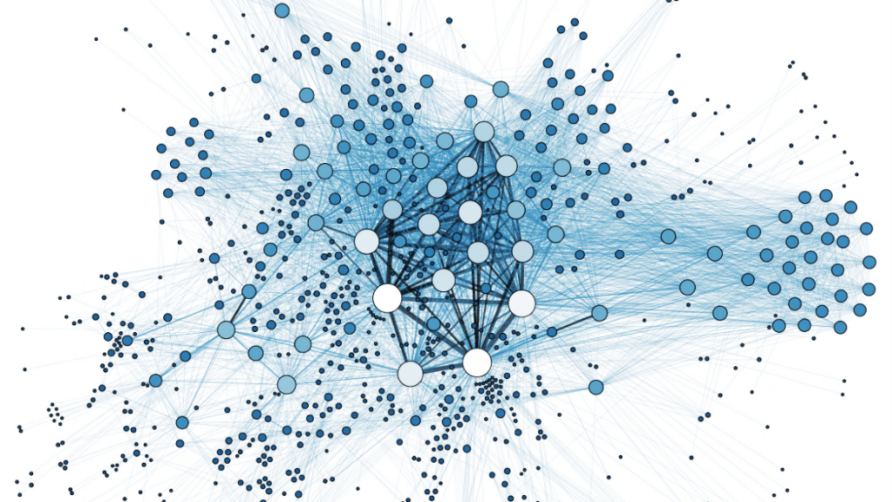

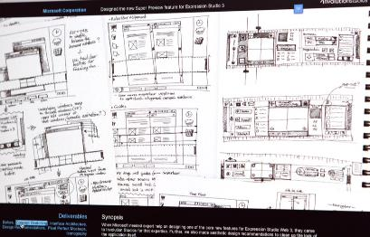
DEPARTMENT OF
COMPUTER SCIENCE
Research
World-class research
(Research Evaluation 2016-2020)
Extensive collaboration with Danish and international companies
Key areas:
  • Embedded software systems
  • Cyberphysical systems
  • Artificial intelligence and machine learning
  • Data intensive systems
  • Big data
  • Analytics for spatio-temporale data
  • Software engineering
  • Human-AI interaction
  • Human-Centred Computing
  • Interaction design
  • Internet of Things (IoT)

Slide 20
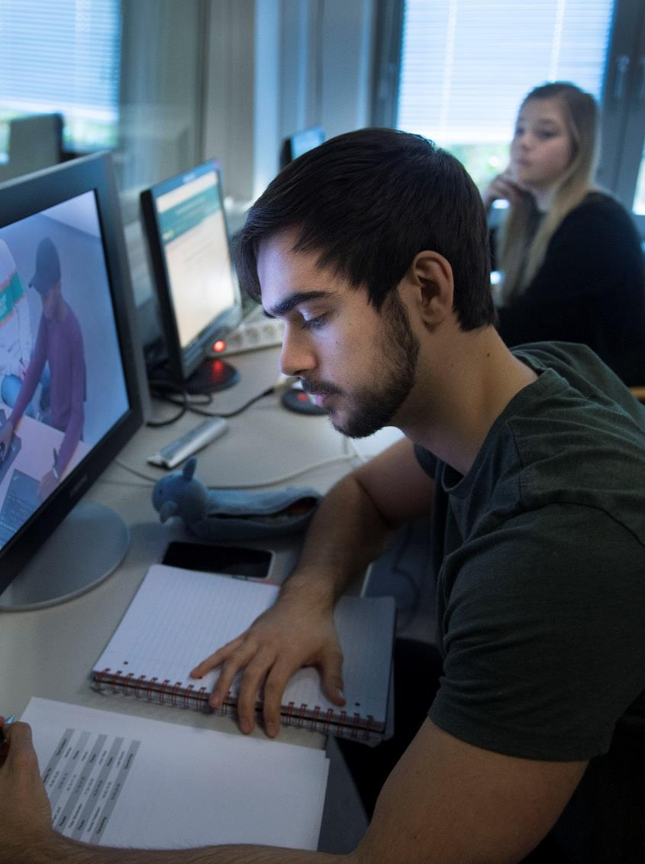
DEPARTMENT OF
COMPUTER SCIENCE
Education
Offers a wide range of classical bachelor’s and master’s programmes like
Software
Computer science
Information technology
In addition, a number of other programmes like
Master in Digitalisation and Application Development for bachelors without a background in IT

Slide 21
DEPARTMENT OF ARCHITECTURE, DESIGN AND MEDIA TECHNOLOGY
Research
ARCHITECTURE
INDUSTRIAL DESIGN
URBAN DESIGN
MEDIA TECHNOLOGY

Slide 22
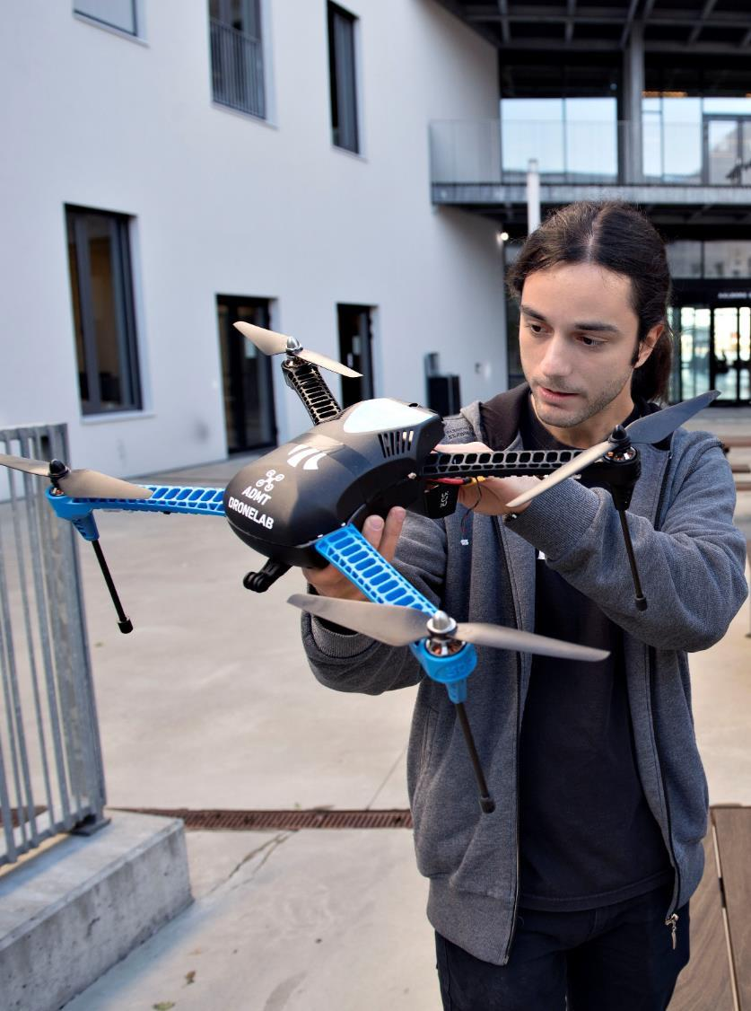

DEPARTMENT OF ARCHITECTURE, DESIGN AND MEDIA TECHNOLOGY
Research
ZERO-energy buildings – sustainable architecture
Urban space, architecture and well-being - can architecture affect stress?
Exclusionary Design – that rejects homless in the city
Architecture as a catalyst for urban development and circular societies
Computer vision & AI for surveillance of sewers
Designed to last- sustainable design
ReshapeWaste – recycling of industrial waste products
Virtual Reality motivates seniors to exercise
Service design creates user-friendly digital solutions, for example for older citizens
Human-robot interaction – for future welfare technology
New design and manufacturing methods in architecture

Slide 23
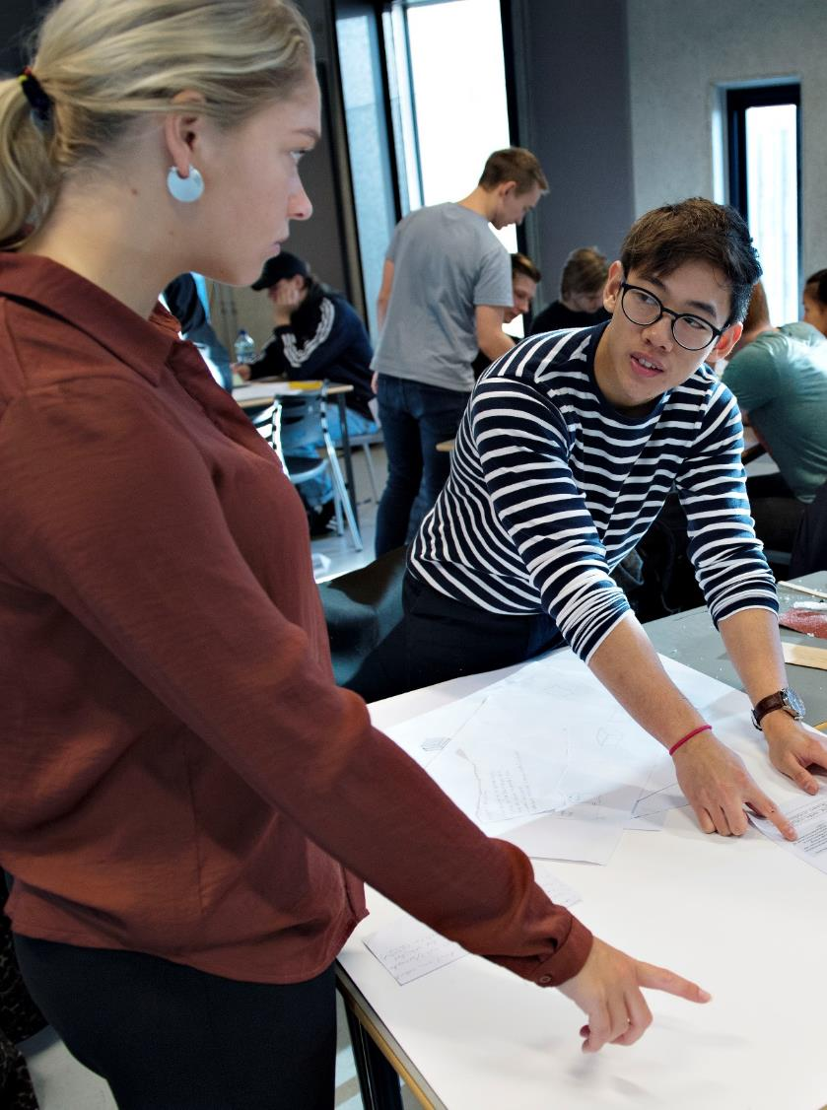
DEPARTMENT OF ARCHITECTURE, DESIGN AND MEDIA TECHNOLOGY
Education
A unique combination of programmes at the Bachelor’s and Master’s levels within architecture, design and mediatechnology
This composition, unique in Denmark, creates the foundation for the development of competencies in technology and design with the human being in focus

Slide 24

DEPARTMENT OF
SUSTAINABILITY AND PLANNING
Research
SUSTAINABLE ENERGY SYSTEMS AND PLANNING
ENVIRONMENTAL ASSESSMENT
SUSTAINABLE TRANSITION
SUSTAINABLE PRODUCTION AND CONSUMPTION
MANAGEMENT OF NATURAL RESOURCES
GEOINFORMATICS AND GEODESY
USER-INVOLVED PROCESSES IN TECHNOLOGY DEVELOPMENT AND DIGITALIZATION
MARINE MANAGEMENT
LANDSCAPE AND SURVEYING
SUSTAINABLE DESIGN
CIRCULAR ECONOMY
PBL (PROBLEM BASED
LEARNING)

Slide 25
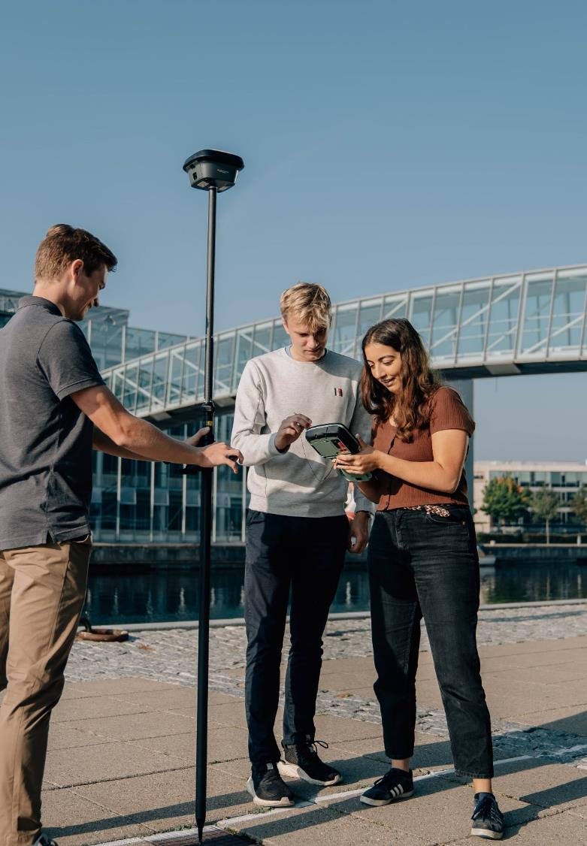

DEPARTMENT OF SUSTAINABILITY AND
PLANNING
Research
Circular economy, technology, sustainable cities, energy, marine management and environmental planning as well as sustainable transition and design.
An internationally strong research environment for life cycle assessments.
The world’s largest research effort in district heating (4DH).
Sustainable and responsible technology development based on real-life issues focusing on the relations between emerging technologies, ecologies and societies.
One of the driving forces behind the regionalisation of EU fisheries policy.
The place where all Danish surveyors are trained.
A world-renowned research environment within problem based learning.

Slide 26
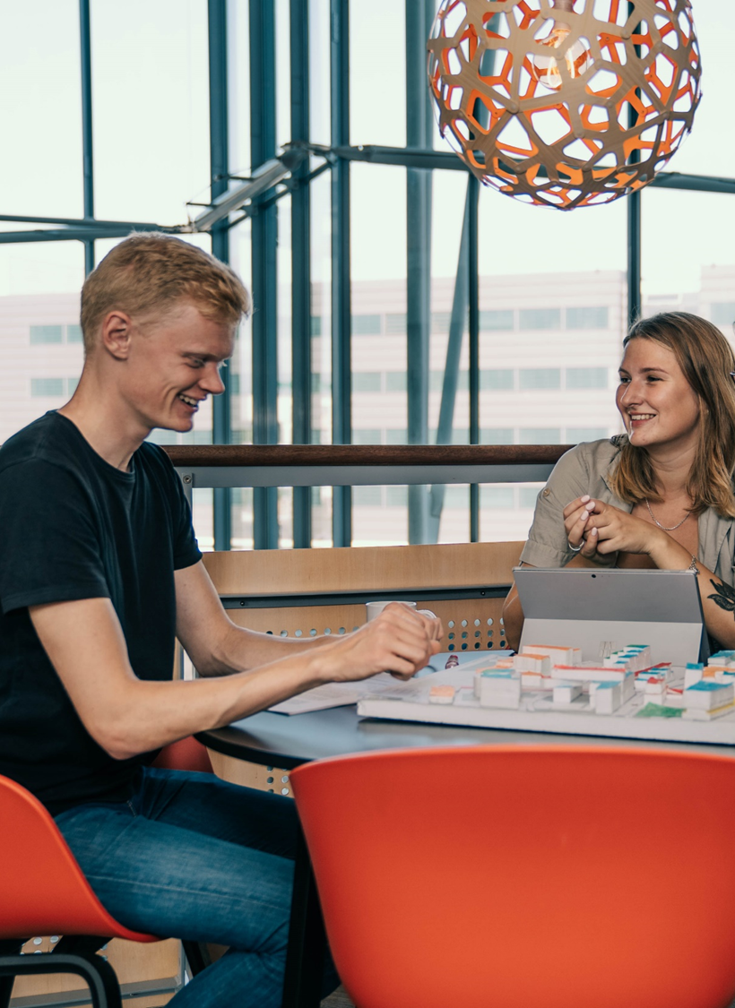

DEPARTMENT OF SUSTAINABILITY AND
PLANNING
Education
Offers a wide variety of Bachelor’s and Master's programmes in both Aalborg and Copenhagen in development and planning.
With a portfolio ranging:
from socio-technical, environmental, international and administrative aspects
to spatial planning, sectoral planning
and land management
to technical disciplines such as
surveying and mapping
All with focus on sustainability

Slide 27
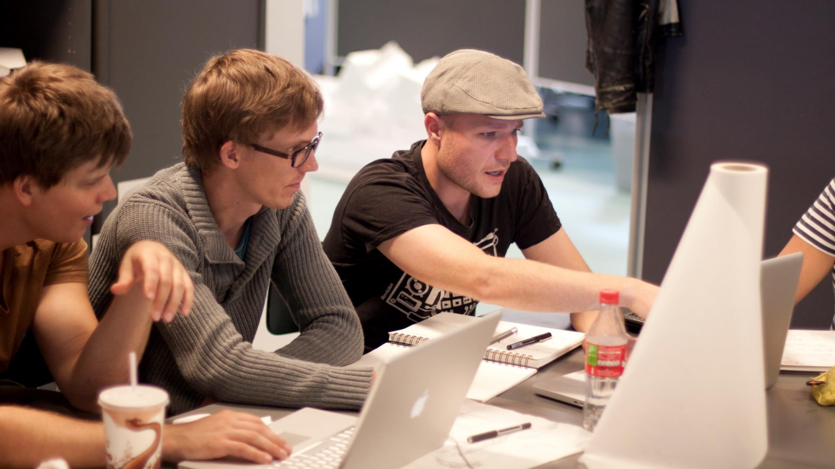
EDUCATION

Slide 28
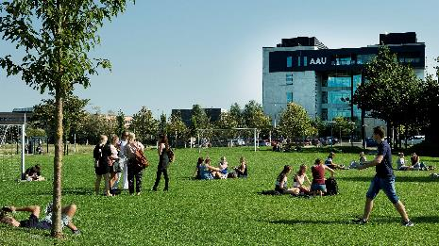

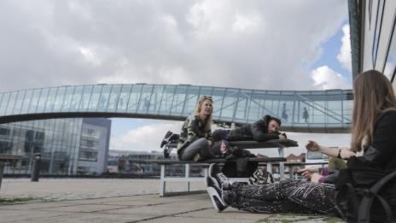
PROGRAMMES AT TECH
Education
AALBORG
We train the graduates of the future in:
IT  Electronics  Architecture  Design 
Sustainability  Planning
Aalborg – since 1974
Copenhagen – since 2003
COPENHAGEN
Notes:
DK-billede erstattes: https://www.colourbox.com/vector/denmark-vector-2332864

Slide 29
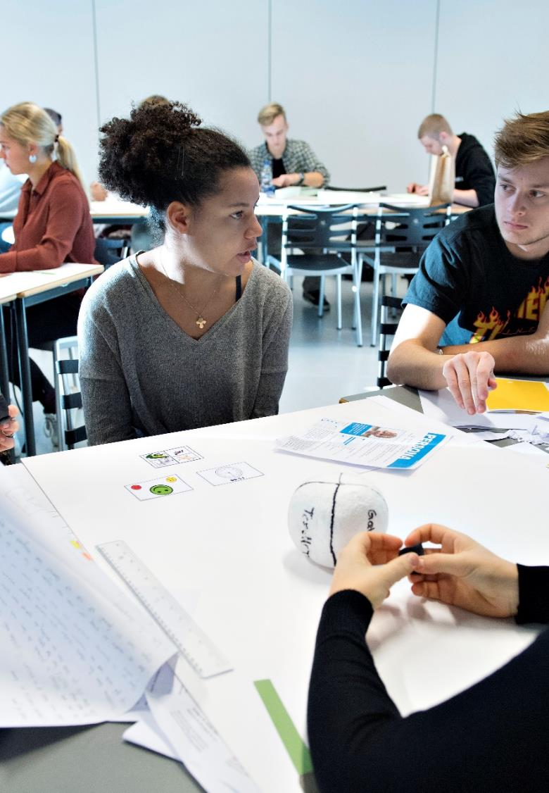
PROBLEM BASED PROJECT WORK
Education
A consistent and central element in all programmes at AAU.
Provides natural cooperation between students and external partners on authentic challenges
Requires critical assessment of the starting point, and results in a broader perspective that goes beyond the individual discipline
Ensures integration of interdisciplinarity

Slide 30


PROBLEM BASED LEARNING (PBL)
Education
P B L
AAU is among the best in the world in teaching with its unique PBL approach
PBL programmes are in demand nationally and internationally
AAU is home to a UNESCO-center for Problem Based Learning in Engineering Sceience and Sustainbility

Slide 31

RESEARCH

Slide 32
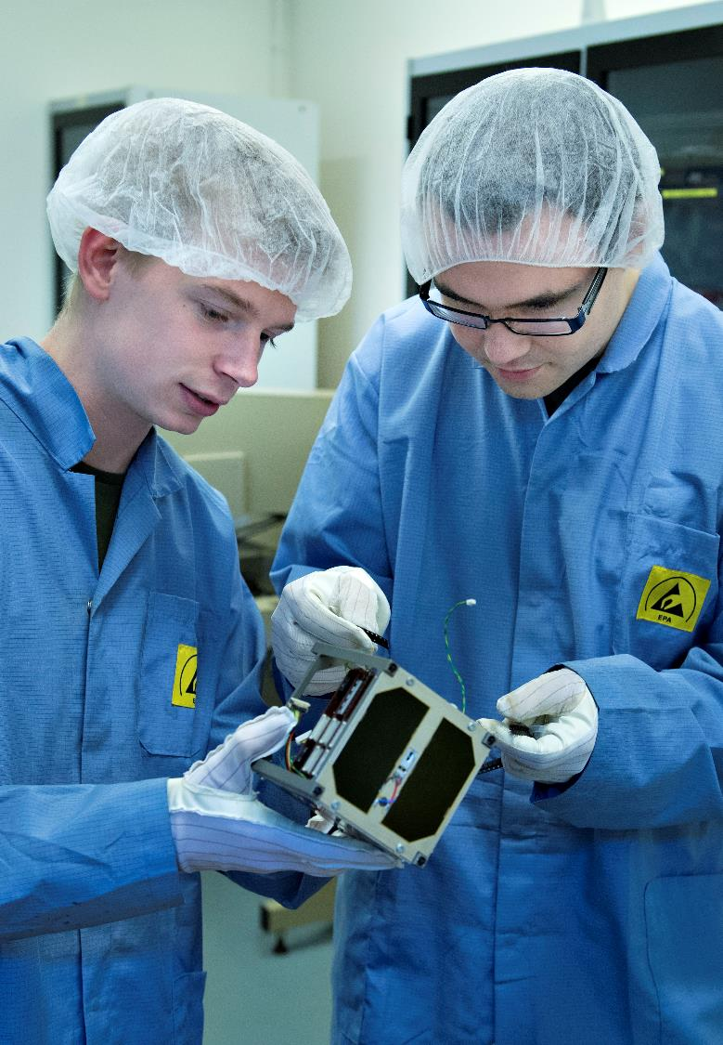
RESEARCH
Research
Internationally recognized research environments
World leader in several research environments
High quality research
Holistic research generated in interaction with society
Contributing to solutions for the current major challenges
Contributing to society's prosperity and development
Close collaboration with the business community

Slide 33
STRONG RESEARCH AREAS
ELECTRONIC SYSTEMS
COMPUTER SCIENCE
Antennas and mobile technology
Wireless communication
Acoustics and audio technology
Automation & Control
Navigations and Communications
Signal processing
Embedded software systems
Data-intensive systems and Big Data
Interaction design and system
development
Cyber Physical Systems
Spatio-temporal data analysis
Artificial intelligence and
machine learning
SUSTAINABILITY AND PLANNING
ARCHITECTURE, DESIGN
AND MEDIA TECHNOLOGY
Sustainable energy systems
Problem based learning (PBL)
Circular economy and environmental assessment
Sustainable design and technologically transition
Architecture and design
Urban design and mobility
Industrial design
Media technology and Artificial Intelligence

Slide 34
MAKING A MARK IN THE WORLD
Research
changes to the
EU strategy for
district heating
Intelligent
refrigeration
containers
that can reduce
food waste
software
that identifies what data companies collect on us
the development
of satellites for
e.g. monitoring shipping
better
hearing aids
using machine
learning and
artificial neural networks
From VIRTUAL REALITY
that gets seniors to exercise to …
digital communities for youth with cognitive disabilities
development
of sustainable
urban areas
worldwide
unique lab
contributes to
reducing the
enormous
global water
wastage
shorter
travel time
and lower CO2 emissions with intelligent
traffic lights

Slide 35
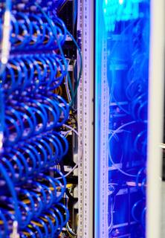
DIGITAL INFRASTRUCTURE AND ADVICE
Research
CLAAUDIA: Research Support through IT, Data Science and Data Management
CLAAUDIAS THREE PILLARS:
A hardware/software platform for computations and data handling
Data management which includes advice, data archiving, etc.
Data science knowledge: Competence building and detailed interaction between a research group and CLAAUDIA specialists

Slide 36
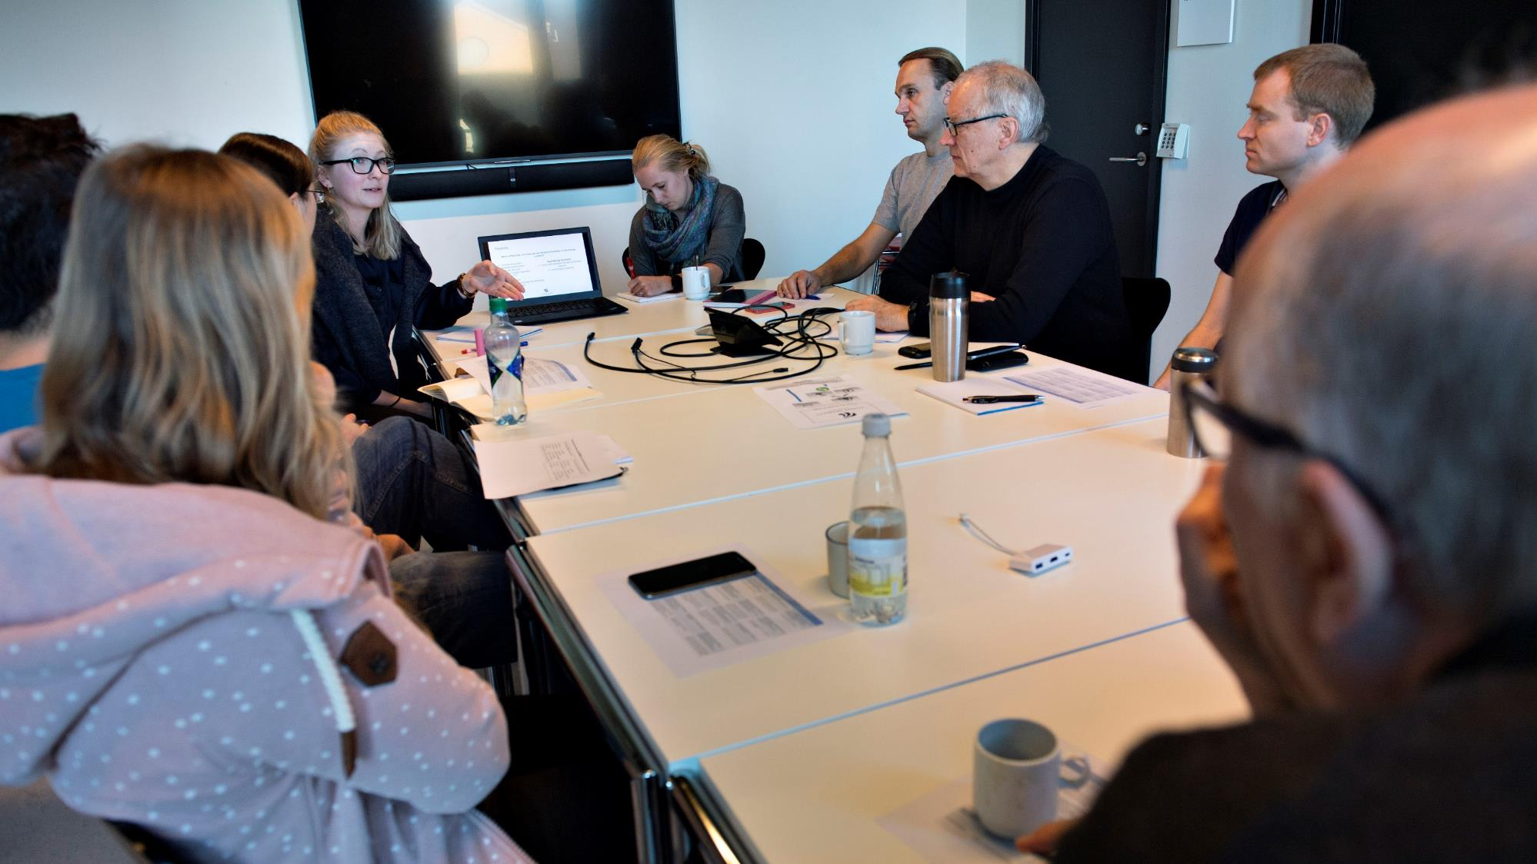
KNOWLEDGE COLLABORATION

Slide 37
AAU HAS STRONG COLLABORATION SKILLS
Collaboration
THE PREFERRED COLLABORATION PARTNER OF THE DANISH BUSINESS WORLD
FLEXIBLE APPROACH TOWARDS COLLABORATION
THE BEST AT ESTABLISHING COLLABORATION AGREEMENTS
AAU ranks first on the list from the Confederation of Danish Industry (DI) of how satisfied Danish companies are with collaborating with Danish universities
Research-intense companies consider AAU to be the best Danish university at handling the process from patent to commercialisation
Between 500 and 600 research partnerships are annually established between AAU and public/private actors
Notes:
Collaborative research with universities is vital for the innovation, productivity and growth of companies. Even the knowledge of companies with their own development departments is limited. Therefore, external input, ideas and knowledge are vital.
In DI’s report from 2016, research-intensive companies state that the reason for their assessment of Aalborg University is that AAU has a flexible and pragmatic approach towards collaboration with companies.
Source: Report from the Confederation of Danish Industry, DI Analyse (2016): Knaster i samarbejde om forskning – men også positive tendenser [Hurdles in research collaboration - as well as positive trends].
THE PREFERRED COLLABORATION PARTNER OF THE DANISH BUSINESS WORLD
Source: DI (2021): Danmark på vidensporet V [Denmark on Knowledge Track V]
FLEXIBLE APPROACH TOWARDS COLLABORATION
Source: Report from the Confederation of Danish Industry, DI Analyse (2016): Knaster i samarbejde om forskning – men også positive tendenser [Hurdles in research collaboration - as well as positive trends].
THE BEST AT ESTABLISHING COLLABORATION AGREEMENTS
Source: Ministry of Higher Education and Science (2021): Viden til vækst – Offentlig-privat samspil om forskning [Knowledge for growth – Public-private interaction on research] (kommercialiseringsstatistikken)

Slide 38



Collaboration
AAU HAS STRONG COLLABORATION SKILLS
Best Danish university
for partnering with industry
Confederation of Danish Industry (DI
COOPERATION AGREEMENTS
AAU IT ENTREPRENURS
Annually, about 600 new research agreements with public and private actors, incl. major digital businesses like Bang & Olufsen and Nokia Bell Labs.
Annually, AAU supports about 80 potential IT entrepreneurs with the help of AAU Student Entrepreneurship.

Slide 39

INNOVATION AND
KNOWLEDGE COLLABORATION
Collaboration
BINDING, FOCUSED, MUTUAL
Cluster partnerships
Entrepreneurship
SME partnerships
Strategic partnerships
Industrial researchers, professors, etc.
Student collaboration (projects, internships, student jobs)
Research and development partnerships
Notes:
https://www.colourbox.com/image/business-concept-young-business-woman-image-30601685

Slide 40







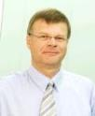


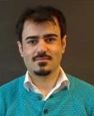








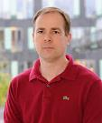
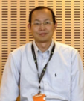
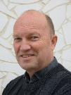
20%-PROFESSORS
Collaboration
Shared work hours: Normally 20% at the university and 80% in a company that collaborated with AAU.
Contribute to the strong link between the faculty and the business community.
Carsten S. Kallesøe
Senior Specialist
Søren Bech
Research Director
Jesper Raakjær
Head of Development
Roozbeh Izadi-Zamanabadi
Lead Expert
Kamal Nasrollahi
Head of Machine Learning
Klaus I. Pedersen
Senior Wireless Network Specialist
Jesper Jensen
Senior Research
Engineer
Hans Peter Schwefel
Managing Director
Anders Læsø Madsen
Chief Executive Officer
Zhinong Ying
Principal researcher
Bo Pedersen Weidema
Senior Consultant

Slide 41



EXAMPLES OF COMMERCIALIZATION
Collaboration
Nanosatellites, components and entire space missions
From three AAU-students to more than 200 employees
Main headquarters in Aalborg in Denmark, propulsion technology center in Uppsala in Sweden and satellite & constellations operations center in Luxembourg
Clients in over 60 countries
Market value in the DKK 3-digit millions
Reliable wireless connections for industry, drones and defense
  Founded by researcher from AAU and businessman
  Clients all over the world
  Market value in the DKK 2-digit millions
Software for fast and efficient data sharing via networks
Founded by researchers from AAU and MIT
Clients all over the world
Market value in the DKK 2-digit millions
Notes:
https://www.electronic-supply.dk/article/view/793929/gomspace_skal_hyre_5060_nye_medarbejdere_som_folge_af_starticalkontrakten
https://gomspace.com/UserFiles/GomSpaceQ12021.pdf

Slide 42
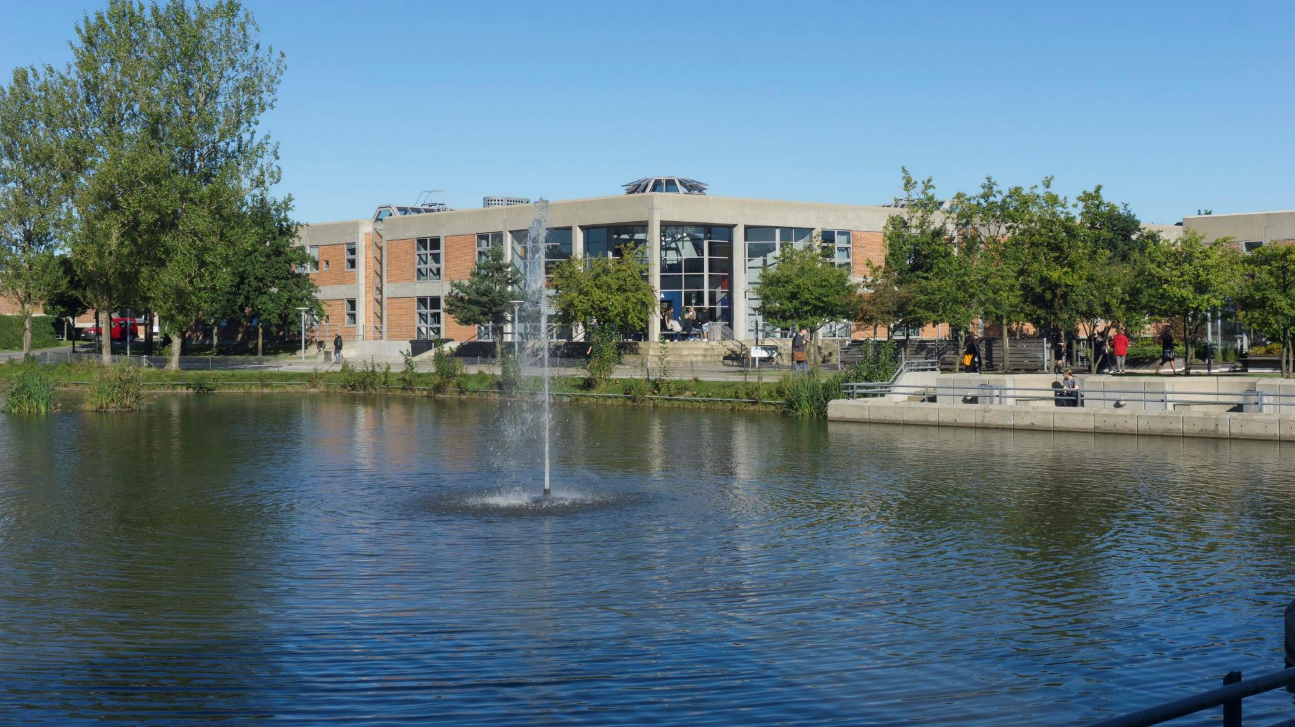
Thank you

Slide 43

Find more information about
The Technical Faculty of IT and Design on:
en.tech.aau.dk/

