Slide 1


Group conversation concept
General Student Guidance - July 2024

Slide 2
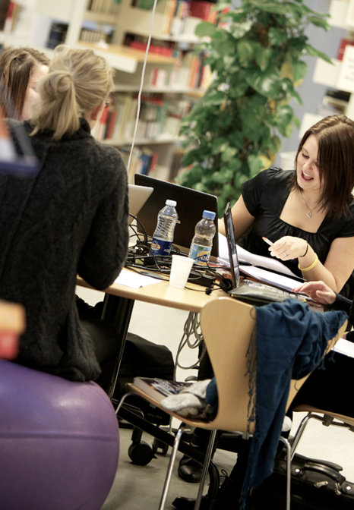
Background for this material on group conversations
Since the end of November 2022, the General Student Guidance has offered group conversations to study groups experiencing collaboration difficulties or simply wishing to improve their teamwork.
In this material, as an academic advisor, you have the opportunity to gain insight into and make use of the scripts and tools we use during these group conversations. You can use the material in its entirety or select parts of it.
If you have any questions about the material, please feel free to contact us at the General Student Guidance.

Slide 3


GROUP CONVERSATIONS - PURPOSE
Contribute to resolving conflicts so that group collaboration can get back on track
Provide insight into typical group dynamics that can either promote or hinder cooperation
Offer tools for aligning expectations regarding collaboration
Foster an understanding of each individual’s contribution to the teamwork
PAGE

Slide 4

A process with a preliminary conversation and up to three sessions
Preliminary conversation with a focus on contact and contract
1st Conversation: 'Temperature check' and focus on the phases of group work
2nd Conversation: Aligning expectations and adjusting collaboration
3rd Conversation: Future workshop

Slide 5

PRELIMENARY CONVERSATION
(45 MIN)
Contact and contract
PAGE

Slide 6
What are the group's challenges about?
The purpose of the conversation is to clarify how each member experiences the collaboration and to reach a shared understanding of what might be important to work on in the upcoming discussions.
The work is based on three questions, with the facilitator ensuring that everyone in the group has a chance to speak (consider setting a time limit for each person's speaking time):
Describe your experience of how the collaboration is functioning right now.
Describe what you hope to gain from the group discussions.
Describe what you wish to contribute to achieve the outcomes you want.

Slide 7
CONVERSATION 1
'Temperature check' and
the phases of group work
PAGE

Slide 8
Script for the 1st conversation
The purpose of the 1st conversation is to 'take the temperature' of the group's collaboration on a more concrete and detailed level than during the initial meeting.
Before the conversation takes place, the 5 questions listed on slide 9 should be sent out to the group. This gives each member the opportunity to reflect on the collaboration in their own time and space.
The conversation begins with a summary of the agreement made during the initial meeting, followed by a round where all group members have the chance to express their experience of the collaboration. During this round, each member is encouraged to propose a wish for improving the collaboration. The round concludes with all members considering each other's wishes and discussing whether they can and are willing to address them.
The conversation ends with a discussion on the group's process—how the group has progressed through different phases and whether there are phases that need to be revisited to optimise collaboration (refer to the model on slide 10 and to the exercise on slide 1).
PAGE

Slide 9
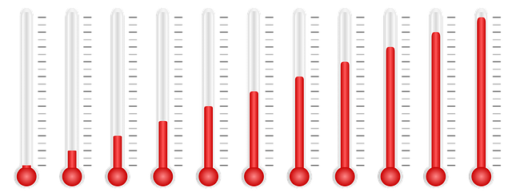
Temperature measurement
When/in what situations do you experience challenges?
How does it affect you? (Mentally, physically, in terms of actions)
How/when does it impact others in the group or your collaboration?
In what situations do you find the group helpful or relevant?
What more would you like from the group?

Slide 10
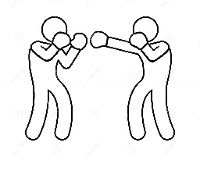




The phases of group work
Forming
Storming
Norming
Performing
Adjourning
Strength:
The foundation for the group should be built through relationships. Members are friendly and avoid conflicts.
Each student tries to form expectations about what it means to be a student.
Downside:
To succeed together, the group needs to dare to step out of this "comfort zone."
Strength:
Honest discussions, disagreements, and evaluations of the collaboration within the study group.
This typically occurs during the first major assignment.
Downside:
The study group needs to be able to handle disagreements together; otherwise, it could lead to long-term conflicts.
Strength:
The study group establishes agreements, routines, and a shared "everyday" approach to their work.
Downside:
It can be difficult to renegotiate established agreements, and some students may find it challenging to break away from the culture that the group has created.
Strength:
The study group optimises collaboration based on relations, disagreements, and previously made agreements.
The group has established effective work routines but can still pause to evaluate and adjust as needed.
Downside:
Not all study groups reach this level before changes "push the group back."
Strength:
Natural dissolution of a group, e.g., due to the end of a semester or changes in the assignment, provides an opportunity for closure and process evaluation.
Downside:
It can be risky and potentially painful for many students if the group dissolves prematurely due to conflicts, or if only a few students are excluded.
PAGE
Notes:
Hvis vi kigger på den her fasemodel, hvor I kan se de faser et gruppearbejde går gennem, så vil grupper, der er etableret med et relationsfokus typisk have meget nemt ved at gå gennem den første fase, men man vil typisk springe over fase to – stormingfasen, hvor man bokser med hinanden og udfordrer hinandens perspektiver og når frem til beslutninger. At man springer over denne fase leder ofte til konflikt senere i forløbet, når man skal til at performe: "Jeg troede, vi var enige om"-konflikter....
Men der kan være andre måder at danne grupper på end gennem relationer...

Slide 11
EXERCISE
In which phase is your group currently?
How have the individual phases played out?
Have you gone through all the phases?
Do you need to revisit any phase?
Forming
Storming
Norming
Performing
Adjourning
PAGE

Slide 12
CONVERSATION 2
Aligning expectations and
adjusting collaboration
PAGE

Slide 13
Script for 2nd conversation
The purpose of the 2nd conversation is to align expectations and adjust the framework for collaboration within the group.
Typically, Conversation 1 provides a solid foundation to build upon, highlighting the strengths and weaknesses of the collaboration. Conversation 2 is an opportunity to delve into the details and concretely establish a revised group contract, ensuring the collaboration moves towards the goals the group desires.
The conversation will use the tool for expectation alignment called 'Handshake.' Before the conversation, slides 14-19 will be sent out, where each member should reflect on and consider their preferences regarding various aspects of the collaboration: relations, direction, rules, framework, and roles.
The outcome of the conversation will be a revised expectation alignment and a new group contract.
PAGE

Slide 14

ALIGNING EXPECTATIONS –
HANDSHAKE
HANDSHAKE – THE FIVE FINGERS
  RELATIONS
  DIRECTION
  RULES
  FRAMEWORK
  ROLES
  [Tanggaard & Mellon (Red.) 2018]
PAGE
Notes:
Håndslaget
Langt de fleste konflikter opstår som følge af manglende forventningsafstemning!
Forventningsafstemning er et ord I nok allerede har hørt rigtig meget og I kommer til at høre det uendeligt meget fra nu af. Både her på AAU og også på den anden side.
Og det er fordi det er et af de vigtigste værktøjer til at forstå hinandens bevæggrunde for hvorfor man reagerer, arbejder og kommunikere som man gør.
Ofte opstår udfordringer i samarbejde når vi ikke kender hinandens bevæggrunde, og derfor er det utrolig vigtigt at man bruger god tid på at sikre sig, at der er en flydende, respektfuld og åben kommunikation i samarbejdet. Og ´det kan man bruge forventningsafstemning til.
Og jeg har taget et bud på en ‘organiseret’ forventningsafstemning med, som kaldes ‘håndslaget’.

Slide 15


EXERCISE IN CONVERSATION 2
What expectations does the group need to agree on regarding:
Relations?
Direction?
Rules?
Framework?
Roles?
PAGE

Slide 16

RELATIONS
How do we want the social and work-related relationships between us to develop—and how can we make that happen?
What experiences from previous groups do we bring with us, and how might they impact this group?
What values should our collaborative relationships be based on?
PAGE

Slide 17
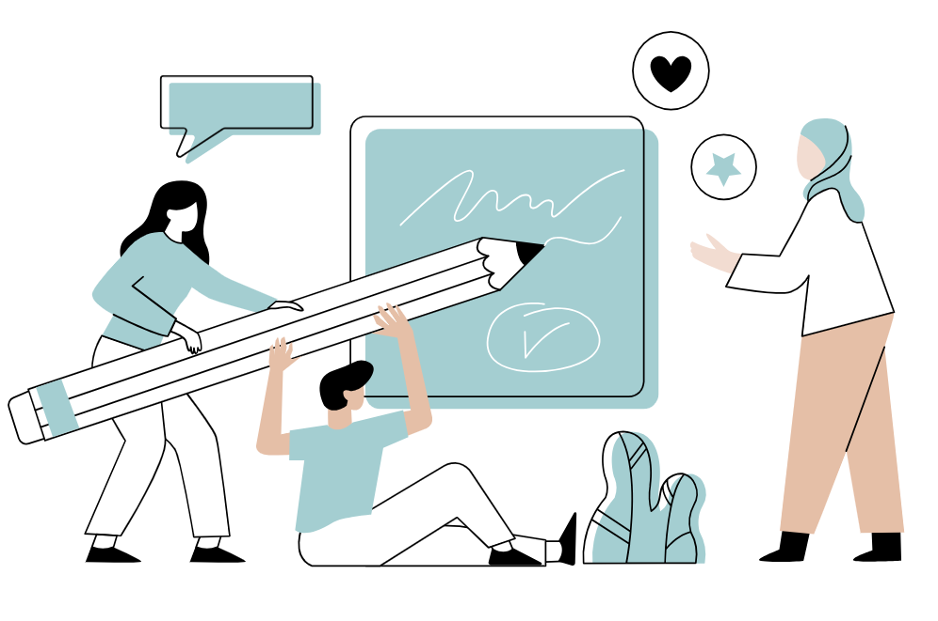
DIRECTION
What do we want to achieve with the task?
  What goals and results are we working towards?
  What do we hope to gain from it?
  Are we agreed on the sub-goals?
How do we ensure that everyone is working towards the same direction?
What will we do if we discover that we are pulling in different directions?
PAGE

Slide 18
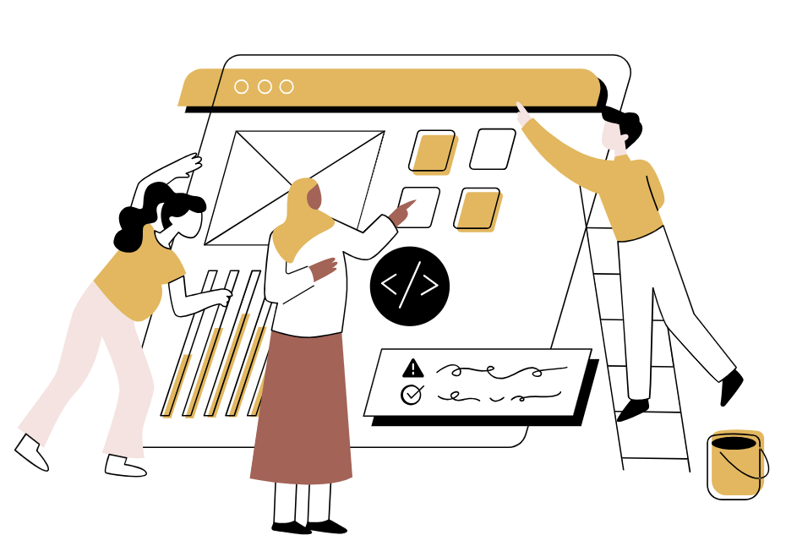
‘HOUSE’ RULES
What 'house' rules should apply to our group?
How can we make these rules practical and avoid having them limit our options?
What experiences do we have with 'house' rules from other groups that could benefit this group?
How will we support each other in the collaboration if and when the rules are interpreted differently and possibly cause disappointments between us?
PAGE
Notes:
Husorden

Slide 19

FRAMEWORK
What boundaries are we working within (e.g., time, resources, physical limitations, etc.)?
What positive experiences do we have/what has worked well in the past?
Can the boundaries be adjusted along the way—if so, in what situations and what might be adjusted?
  How will we review these boundaries during the semester—do they still make sense?
PAGE
Notes:
Hvordan starter og slutter vi møder?
Hvordan melder sig syg?
Hvad hvis man ikke kan nå en opgave?
Hvordan passer vi på hinanden?
Hvordan vil vi gerne håndtere uenighed?
Hvordan gøres de brugbare og hvordan undgår de, at de begrænser vores handlemuligheder?

Slide 20
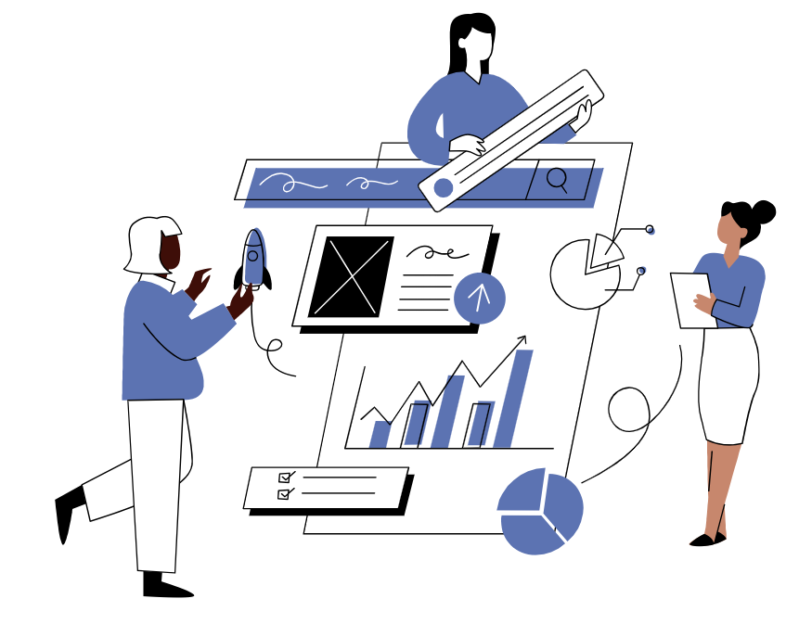
ROLES
How will we distribute the roles among us?
What expectations do we have of each other in the roles we assume?
Can the roles be adjusted along the way—if so, in what situations?
PAGE
Notes:
OBS på både positive ting og risici ved at fastlægge roller for gruppen.

Slide 21
CONVERSATION 3
Future workshop
PAGE

Slide 22
Script for 3rd conversation
The purpose of the 3rd conversation is to both review the experiences gained from the current group collaboration and to explore how these experiences can be applied to future collaborations—both within the current group and in other settings. For example, how will future conflicts be handled? How can good collaboration be maintained?
The conversation is based on three questions that have been sent to the students in advance (refer to slide 23)
Depending on needs, time, and relevance, other tools and topics may also be addressed, such as personality types and interactions, conflict styles, and the interplay and challenges of different conflict styles. (refer to slide 24-28)
PAGE

Slide 23
Preliminary questions
What are the three most important lessons you have learned this semester regarding group work?
How will these lessons impact your approach to group work in the future?
What do you hope for in future collaborations, and what will you contribute to achieve that?
Notes:
Samtalen indledes med, at hver studerende får mulighed for at svare på spørgsmålene.
Spørgsmålene er sendt til de studerende på forhånd.

Slide 24
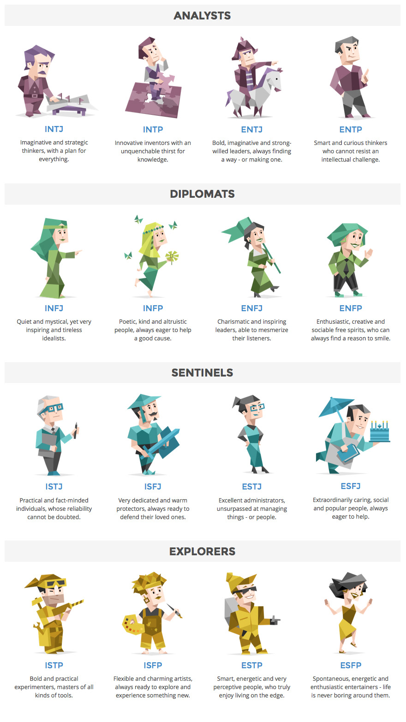
GOOD GROUP COLLABORATION STARTS WITH YOURSELF…
Do you know your own ‘serial number’?
https://www.16personalities.com
Notes:
I bund og grund kan man sige, at en stor del af fundamentet til det gode gruppesamarbejde starter hos dig selv: Hvad er dine styrker, slagsider, præferencer osv – og hvad skal der til for at supplere det`?
Profilerne skal selvfølgelig tages med et gran salt, men det kan være en fin rettesnor, når der skal reflekteres over, hvordan man selv er skruet sammen og hvordan man arbeder sammen med andre – som har helt anderledes præferencer og logikker.
Tasten tages og følges op af følgende spørgsmål i plenum:
Hvilken profil har du?
Hvad er nemt og hvad er udfordrende for dig i sampillet med andre profiler?

Slide 25
GOOD GROUP COLLABORATION STARTS WITH YOURSELF…
Possible Exercise:
What is your own strength and weakness in group collaboration?
What/who would compliment you in a positive way?
What/who would challenge you?
Notes:
I bund og grund kan man sige, at en stor del af fundamentet til det gode gruppesamarbejde starter hos dig selv: Hvad er dine styrker, slagsider, præferencer osv – og hvad skal der til for at supplere det`?
Profilerne skal selvfølgelig tages med et gran salt, men det kan være en fin rettesnor, når der skal reflekteres over, hvordan man selv er skruet sammen og hvordan man arbeder sammen med andre – som har helt anderledes præferencer og logikker.
Tasten tages og følges op af følgende spørgsmål i plenum:
Hvilken profil har du?
Hvad er nemt og hvad er udfordrende for dig i sampillet med andre profiler?

Slide 26

CONFLICT STYLES
Conflicts often escalate because group members use different conflict styles.
While everyone wants the conflict resolved, the methods for handling it vary widely, leading to misunderstandings and increased tension within the group.
PAGE

Slide 27
CONFLICT STYLES
You advocate strongly for your own position and believe your ideas MUST be included.
You explore all sides of the issue and believe that everyone can be right in their own way.
You mediate, meet others halfway, and try to find a compromise.
You withdraw and keep a low profile because you dislike conflicts.
You agree with others even if you disagree, as you prefer to avoid disagreements.
You concede when you believe it benefits the group's work.
You recognise your own part in the problem and are good at empathising with others.
You discuss the problem with others outside or within the group to gain understanding.
You find a scapegoat.
PAGE

Slide 28
CONFLICT STYLES - Exercise
What is your own conflict style?
What kind of conflict style challenge you – and why?
What would you like to improve, when you experience conflict in a group?
PAGE

